Slide 1
K-means Clustering
Mario GONZÁLEZ & Lale ASALIOGLU

Slide 2
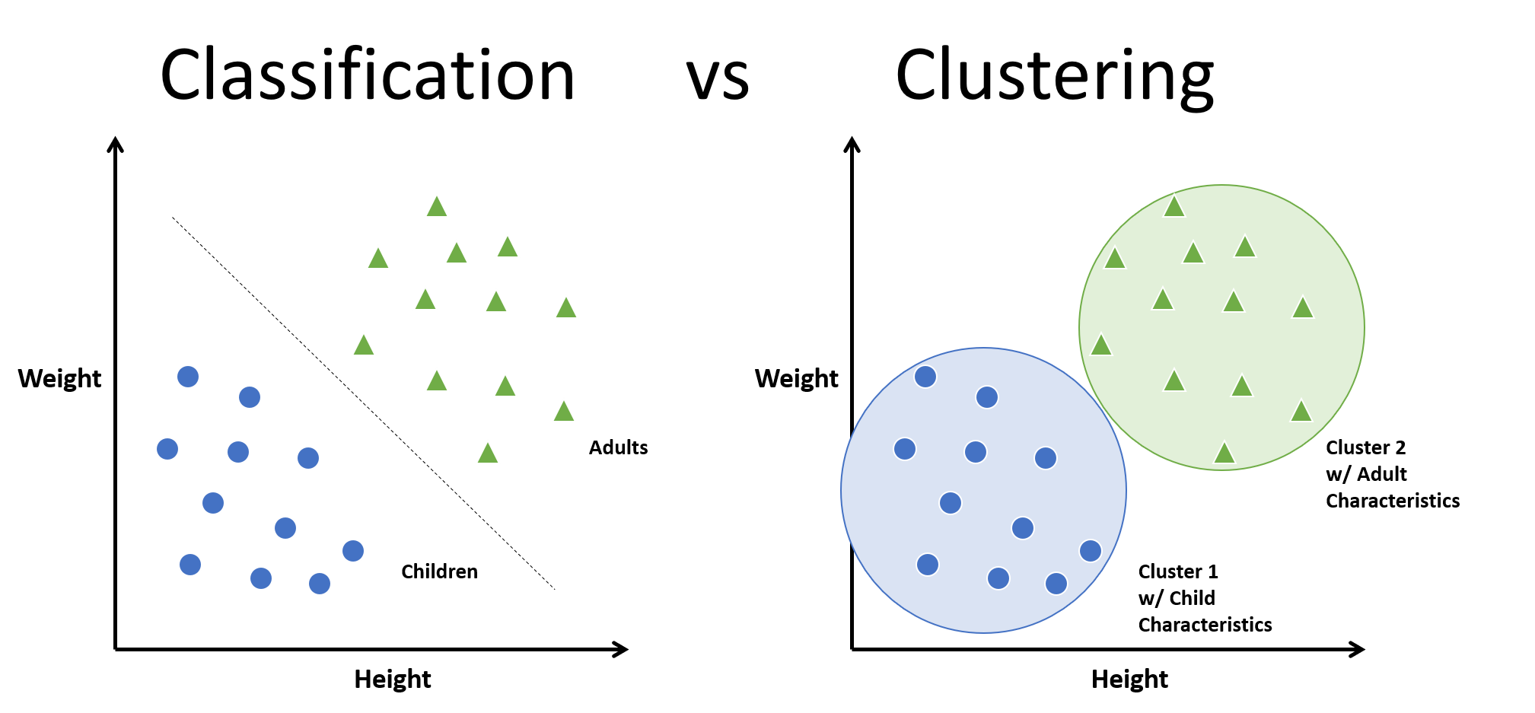
What is Clustering?
Clustering refers to the process of generating labeled groups of data based on how similar they are. Clustering is similar to Classification, but not quite the same…
Characteristics
Clustering is a method of UNSUPERVISED LEARNING
So, it has no target or ground truth to estimate.
Does not have a specific label order
Can group the data through different methods:
K-means
K-nearest neighbors
Hierarchical clustering
Classification vs Clustering

Slide 3
Why do we cluster?
Given a collection of data objects, we want to form groups of data that is similar and dissimilar from other data. When we make these groups we do not really care how our data is presented as long as it is grouped.
A typical cluster contains as a result:
Data observations similar to one another within the cluster
Data observations dissimilar to objects in other clusters

Slide 4
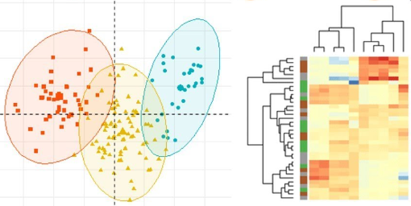
Types of clustering
In this presentation we will focus two types of clustering:
K-means clustering: measures the distance from a data point to a centroid.
Hierarchical clustering: measures the similarity between pairs of ponts and forms clusters from it.
K-means clustering Vs. Hierarchical clustering

Slide 5
K-means clustering
What is it?
An algorithm that groups the data based on its euclidean distance in a certain dimension against a centroid. The data will be separated in K clusters (arbitrary) and calculate the distance of the data to the centroid.

Slide 6
K-means clustering
How does it work?
K-means clustering method works based on the following steps:
The computer has K centroids in determined locations in the data spectrum.
The computer computes the distance between the data points and the centroids.
The computer labels the points that are the nearest to each centroid.
The computer moves the centroid to the mean point of the labeled data.
K-means process

